Slide 1
Lecture#8: C and Assembly Mixing (Chapter#10) Summer, 2025
Embedded Systems with ARM Cortex-M Microcontrollers in Assembly Language and C
CSE331: Microprocessor Interfacing and Embedded Systems
Credit: Dr. Mohammad A. Qayum

Slide 2
Basic Data Types in C
Data Type | Data Size (bits) | Alignment | Data Range
bool | 8 | byte | 0 or 1. Bits 1-7 are ignored
char | 8 | byte | -128 to 127(signed) or 0 - 255(unsigned)
int | 32 | word | -2,147,483,648 to 2,147,483,647(signed) or 0 - 4,294,967,296(unsigned)
short | 16 | halfword | -32,768 - 32,767(signed) or 0 - 65,536(unsigned)
int | 32 | word | same as int
long | 64 | word | -9,223,372,036,854,775,808 - 9,223,372,036,854,775,807(signed) or 0 - 18,446,744,073,709,551,616(unsigned)
float | 32 | word | +/- 1.4023x10⁻⁴⁵ to 3.4028x10⁺³⁸, always signed
double | 64 | word | +/- 4.9406x10⁻³²⁴ to 1.7977x10³⁰⁸, always signed
long double | 96 | word | very large range

Slide 3
Load and Store Data
unsigned char | LDRB/STRB
unsigned short | LDRH/STRH
unsigned int | LDR/STR
char | LDRSB/STRSB
short | LDRSH/STRSH

Slide 4
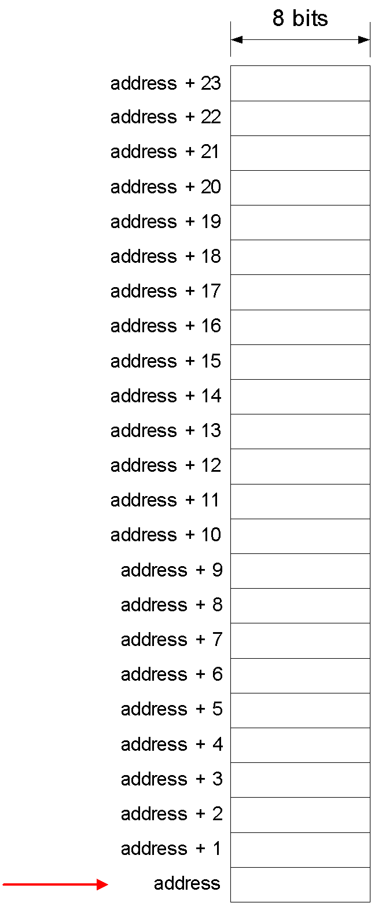
Struct
struct Position {
char x;
char y;
char x;
int time;
short scale;
} array[10];

Slide 5
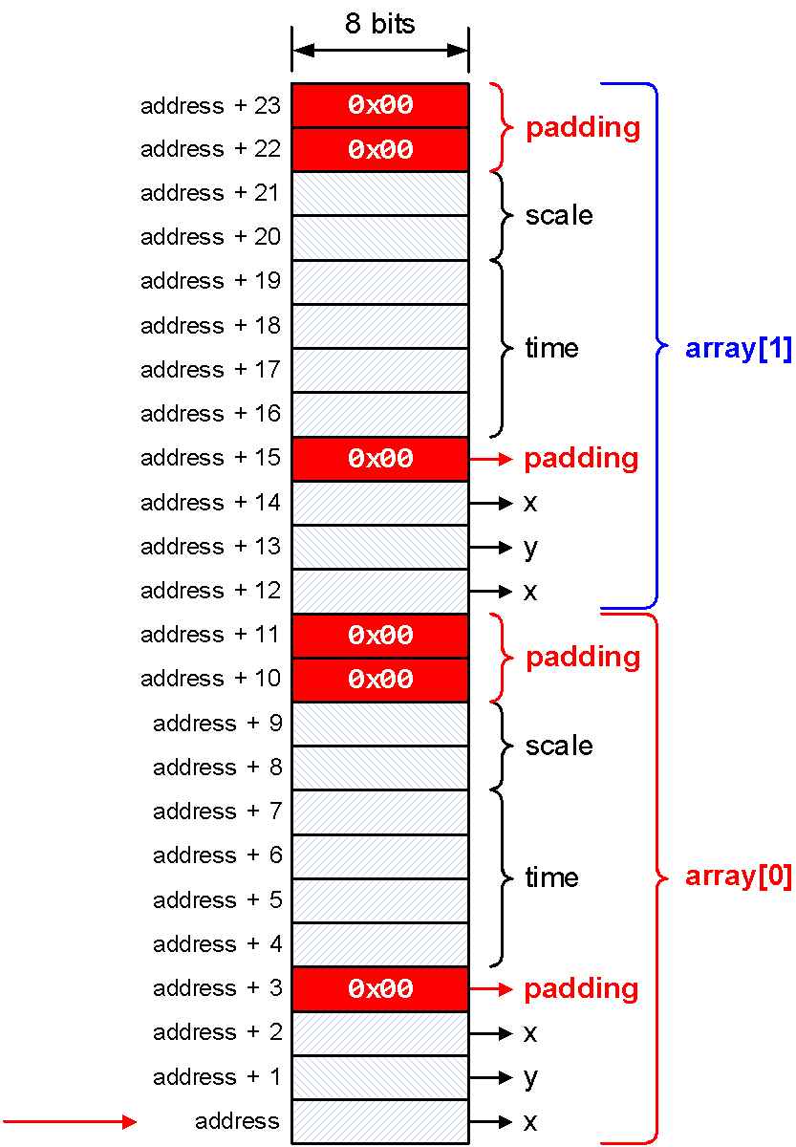
Struct
struct Position {
char x;
char y;
char x;
int time;
short scale;
} array[10];
struct Position {
char x;
char y;
char x;
char padding_1[1];
int time;
short scale;
char padding_2[2];
} array[10];

Slide 6
Struct
__packed struct Position {
char x;
char y;
char x;
int time;
short scale;
} array[10];

Slide 7
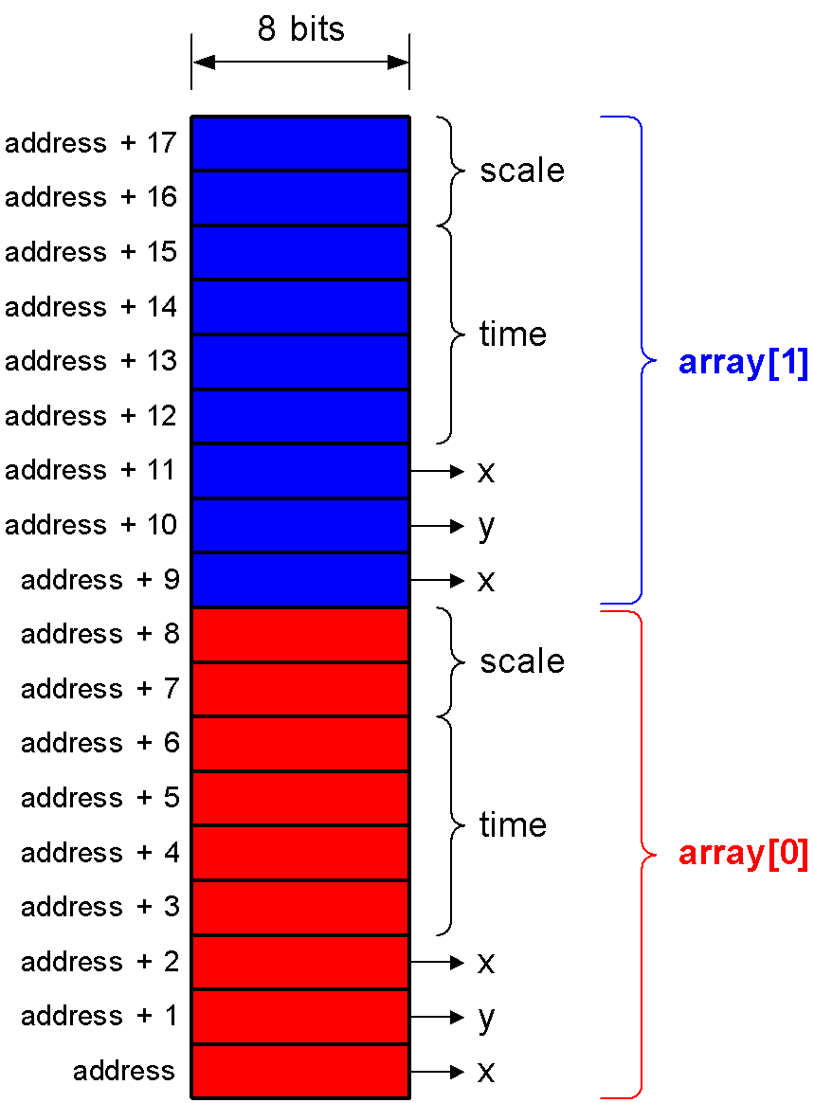
Struct
__packed struct Position {
char x;
char y;
char x;
int time;
short scale;
} array[10];

Slide 8
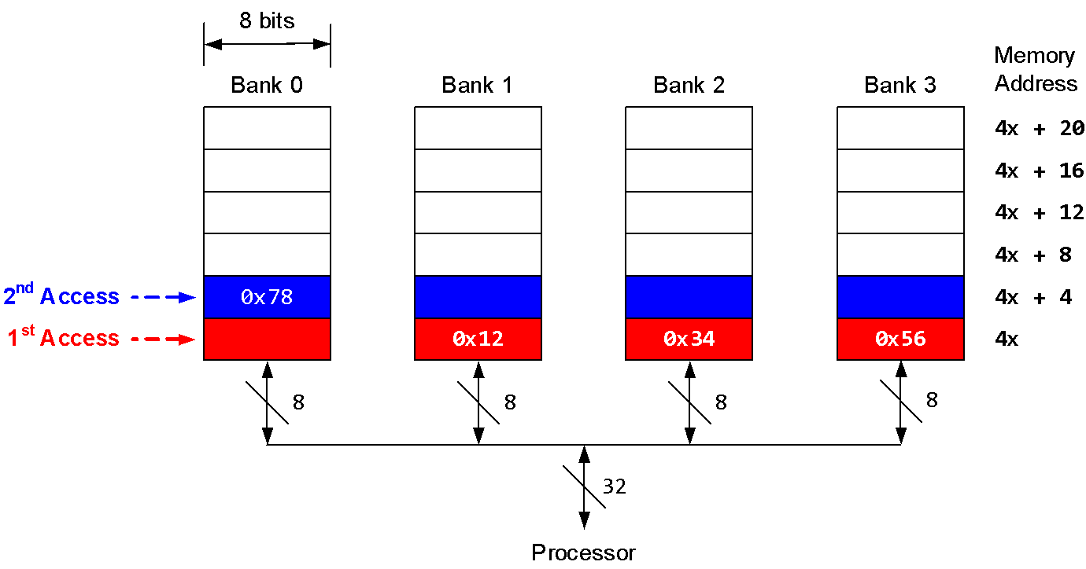
Unaligned Accesses
Two memory accesses are required to fetch the unaligned word!

Slide 9
Struct
struct Position {
char x;
char y;
char x;
char padding_1[1];
int time;
short scale;
char padding_2[2];
} array[10];
__packed struct Position {
char x;
char y;
char x;
int time;
short scale;
} array[10];
Optimized for space
Optimized for speed
(default)

Slide 10
Static Variables
C Code
int foo(); int main(void) { int y; y = foo(); // y = ? y = foo(); // y = ? y = foo(); // y = ? while(1); } int foo() { int x = 5; x = x + 1; return(x) }
C Code
int foo(); int main(void) { int y; y = foo(); // y = ? y = foo(); // y = ? y = foo(); // y = ? while(1); } int foo() { static int x = 5; x = x + 1; return(x); }

Slide 11
Static Variables
C Code | Assembly Code
int foo(); int main(void) { int y; int x=5; y = foo(x); // y = 6 y = foo(x); // y = 6 y = foo(x); // y = 6 while(1); } int foo(int x) { int x = 5; // local variable x = x + 1; return(x) } | AREA static_demo, CODE EXPORT __main ALIGN ENTRY __main PROC BL foo ; r0 = 6 BL foo ; r0 = 6 BL foo ; r0 = 6 stop B stop ENDP foo PROC MOV r0,#5 ADD r0,r0,#1 BX LR ENDP END

Slide 12
Static Variables
C Code | Assembly Code
int foo(); int main(void) { int y; y = foo(); // y = 6 y = foo(); // y = 7 y = foo(); // y = 8 while(1); } int foo() { // x is initialized only once static int x = 5; // a static variable x = x + 1; return(x) } | AREA static_demo, CODE EXPORT __main ALIGN ENTRY __main PROC BL foo ; r0 = 5 BL foo ; r0 = 6 BL foo ; r0 = 7 stop B stop ENDP foo PROC LDR r1,=x LDR r0,[r1] ADD r0,r0,#1 STR r0,[r1] BX LR ENDP AREA myData, DATA ALIGN x DCD 5 END

Slide 13
Example of C Calling Assembly
C Program (main.c) | Assembly Program (strlen.s)
char str[25] = "Hello!"; extern void strlen(char* s); int main(void){ int i; i = strlen(str); while(1); } | AREA stringLength, CODE EXPORT strlen ; make strlen visible ALIGN strlen PROC PUSH {r4, lr} ; preserve r4 and lr MOV r4, #0 ; initialize length loop LDRB r1, [r0, r4] ; r0 = string address CBZ r1, exit ; branch if zero ADD r4, r4, #1 ; length++ B loop ; do it again exit MOV r0, r4 ; place result in r0 POP {r4, pc} ; exit ENDP

Slide 14
Example of Accessing C Variables
C Program (main.c) | Assembly Program (count.s)
int counter; extern int getValue(); extern void setValue(int c); void increment(); int main(void) { int c = 0; setValue(1); increment(); c = getValue(); while(1); } void increment(){ counter += 2; } | AREA count, CODE IMPORT counter ALIGN setValue PROC EXPORT setValue LDR r1, =counter STR r0, [r1] BX lr ENDP getValue PROC EXPORT getValue LDR r1, =counter LDR r0, [r1] BX lr ENDP increment PROC EXPORT increment [WEAK] LDR r1, =counter LDR r0, [r1] ADD r0, r0, #1 STR r0, [r1] BX lr ENDP END

Slide 15
Weak definitions in ARM
A function definition, or an exported label in assembler, can also be marked as weak, as can a variable definition. In this case, a weak symbol definition is created in the object file.
A weak definition can be used to resolve any reference to that symbol in the same way as a normal definition. However, if another non-weak definition of that symbol exists in the build, the linker uses that definition instead of the weak definition, and does not produce an error due to multiply-defined symbols.

Slide 16
Example of Assembly Calling C
Assembly Program (main.s) | C Program (strlen.c)
AREA my_strlen, CODE EXPORT __main IMPORT strlen ALIGN ENTRY __main PROC LDR r0, =str BL strlen stop B stop ENDP AREA myData, DATA ALIGN Str DCB "12345678",0 END | int strlen(char *s){ int i = 0; while( s[i] != '\0') i++; return i; }

Slide 17
Example of Accessing Data Defined in Assembly
Assembly Program | C Program
AREA main, CODE EXPORT __main IMPORT getValue IMPORT increment IMPORT setValue ALIGN ENTRY __main MOVS r2,#0 MOVS r0,#1 BL setValue BL increment BL getValue MOV r2,r0 stop B stop AREA myData, DATA EXPORT counter counter DCD 0 END | extern int counter; int getValue() { return counter; } void increment() { counter++; } void setValue(int c) { counter = c; }

Slide 18
Mixed C & Assembly example
void myfunc(){ //int *i, *j; int *j; //i=0x100200; j=0x100208; *j=0x21; } extern int counter; int main() { int x =2; int y=4; int z=5; int *p, *q; p=0x100200; q=0x100204; //*q=12; *p=sum(x,y,z); *q=counter; return 0; } | int sum (int a, int b, int c) { __asm( //".extern counter\n" ".data\n" "counter: .word 0x13\n" ".text\n" "push {r4, lr}\n" //".extern val: .word 6\n" "add r4, r0, r1\n" "add r4, r4, r2\n" "b hello\n" "hello: mov r0, r4\n" "bl myfunc\n" "pop {r4, lr}\n" "bx lr\n" ); }

